Slide 1
ESL Computer Basics
Gavilan Community College
Spring 2017

Slide 2
AB 104-Computer Work Group 2016-2017
Courses developed by:
Nicole Cisneros
Frank Mendez
Celise ElKassed
Courses taught by:
Martin Rodriguez Juarez
Celise ElKassed

Slide 3
Computer Work Group Goals
One of the goals we have set under AB 104 is to create four vocational ESL options for the ESL students in our consortium - Morgan Hill, Gilroy, Hollister, San Juan and Aromas. The areas of study include: Computer Skills, Family Childcare, Entrepreneurship, and Landscaping. These contextualized courses will be designed in modules that can be offered in different locations at different times of day and at different points during the school year. Upon completing one or more modules, a student will have the skills necessary to advance in his/her job. These will be Noncredit courses under the ESL Department. These new courses will create different pathways for ESL students once they complete one or more of the ESL Lifeskills courses.

Slide 4
Courses
Keyboarding (up to 18 hours) and 5 basics courses (9 hours each)
41137 | ESL 706 | NC COMPUTER-INTERNET BASICS | COMPUTER TECH CENTER: ROOM: | CELISE EL KASSED | F | 600P | 900P | 2/3/2017 | 2/17/2017
41138 | ESL 706 | NC COMPUTER-INTERNET BASICS | HOLLISTER BRIGGS ROOM: 3 | MARTIN RODRIGUEZ | F | 600P | 900P | 2/3/2017 | 2/24/2017
41139 | ESL 707 | NC PRESENTATION BASICS | COMPUTER TECH CENTER: ROOM: | CELISE EL KASSED | F | 600P | 900P | 3/3/2017 | 3/17/2017
41140 | ESL 707 | NC PRESENTATION BASICS | HOLLISTER BRIGGS ROOM: 3 | MARTIN RODRIGUEZ | F | 600P | 900P | 3/3/2017 | 3/17/2017
41141 | ESL 708 | NC WEBSITE DESIGN BASICS | COMPUTER TECH CENTER: ROOM: | CELISE EL KASSED | F | 600P | 900P | 3/24/2017 | 4/14/2017
41142 | ESL 708 | NC WEBSITE DESIGN BASICS | HOLLISTER BRIGGS ROOM: 3 | MARTIN RODRIGUEZ | F | 600P | 900P | 3/24/2017 | 4/14/2017
41143 | ESL 709 | NC EXCEL BASICS | COMPUTER TECH CENTER: ROOM: | CELISE EL KASSED | F | 600P | 900P | 4/21/2017 | 5/5/2017
41144 | ESL 709 | NC EXCEL BASICS | HOLLISTER BRIGGS ROOM: 3 | MARTIN RODRIGUEZ | F | 600P | 900P | 4/21/2017 | 5/5/2017
41145 | ESL 710 | NC WORD PROCESSING BASICS | COMPUTER TECH CENTER: ROOM: | CELISE EL KASSED | F | 600P | 900P | 5/12/2017 | 5/26/2017
41146 | ESL 710 | NC WORD PROCESSING BASICS | HOLLISTER BRIGGS ROOM: 3 | MARTIN RODRIGUEZ | F | 600P | 900P | 5/12/2017 | 5/26/2017

Slide 5
NC Keyboarding Basics for ESL Students
ESL 705: This self-paced course is designed for ESL students who want to familiarize themselves with the alphabetic keyboard by touch and who want to develop their keyboarding speed.

Slide 6
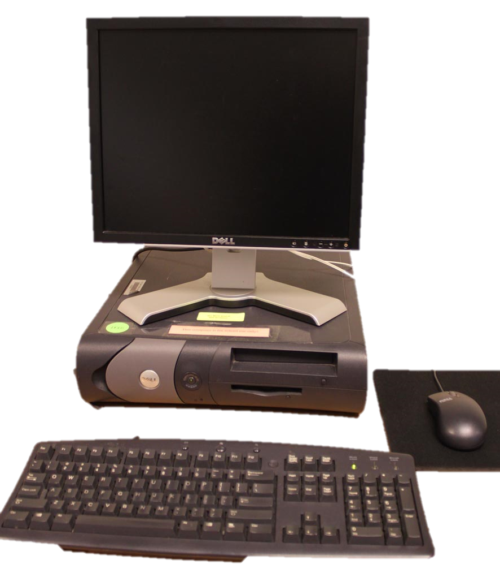
NC Computer and Internet Basics for ESL Students
ESL 706: This course is for ESL students who have little to no experience with computers and navigating the Internet. This course will introduce students to the parts of a computer, basic desktop tools, browsers, email, security, virus protection, and social media.

Slide 7
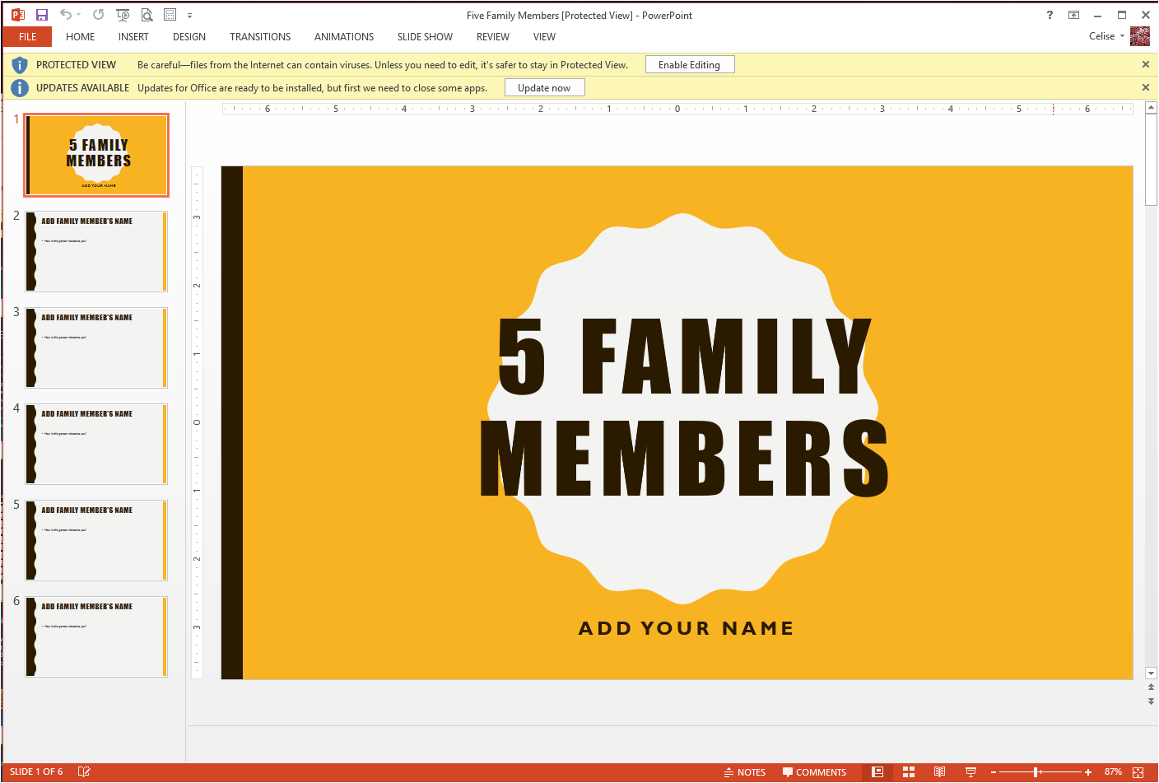
NC Presentation Basics for ESL Students
ESL 707: This course introduces ESL students to presentation graphics using Microsoft Office's "Power Point" software to create a computerized presentation (slide show) with text and objects.

Slide 8
NC Website Design Basics for ESL Students
ESL 708: This course provides ESL students with a basic introduction to website design, from planning page layouts to publishing a complete site to the web. Students will learn how to use a theme based website builder to create their own personal or business website.

Slide 9
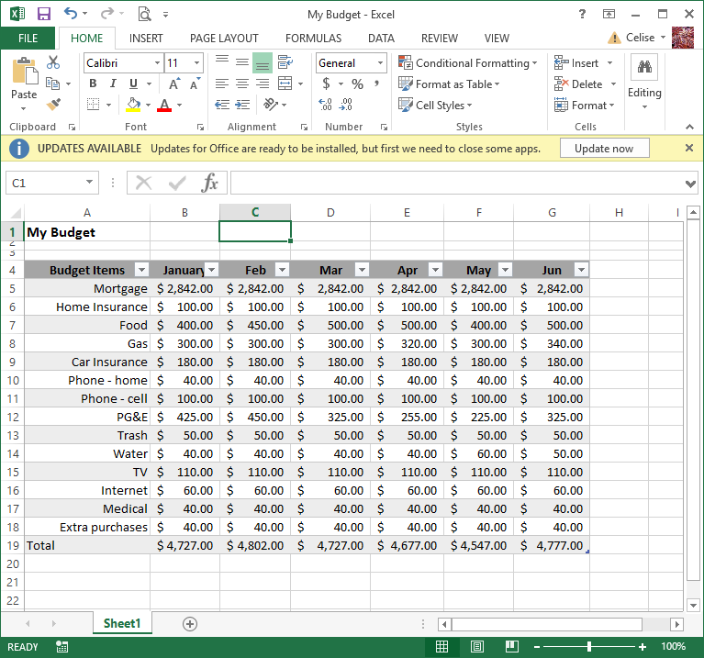
NC Excel Basics for ESL Students
ESL 709: This course provides ESL students with an introduction to the terms, commands, and applications of a spreadsheet program.

Slide 10
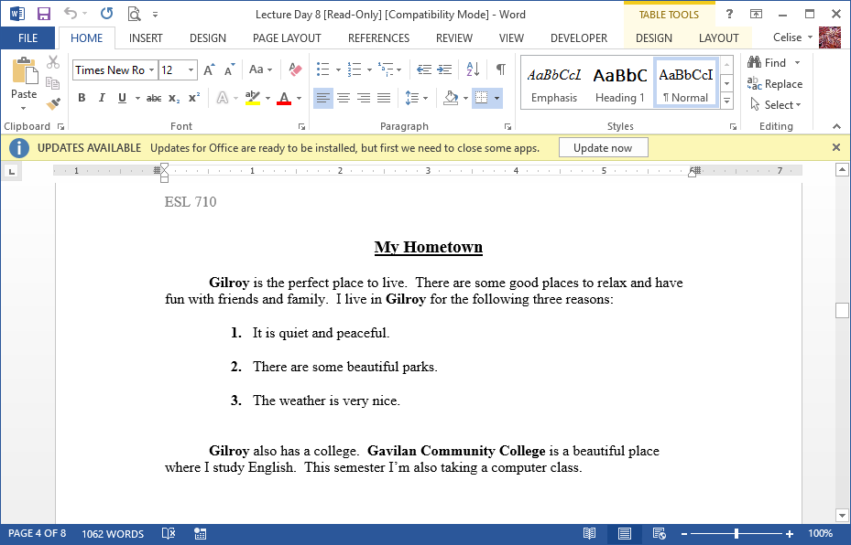
NC Word Processing Basics for ESL Students
ESL 710: This course introduces ESL students to the basic word processing skills of creating, saving and printing a document. Students will also learn to cut, copy and paste text, change fonts and styles, and use the spelling, grammar and thesaurus features.

Slide 11
Extras

Slide 12
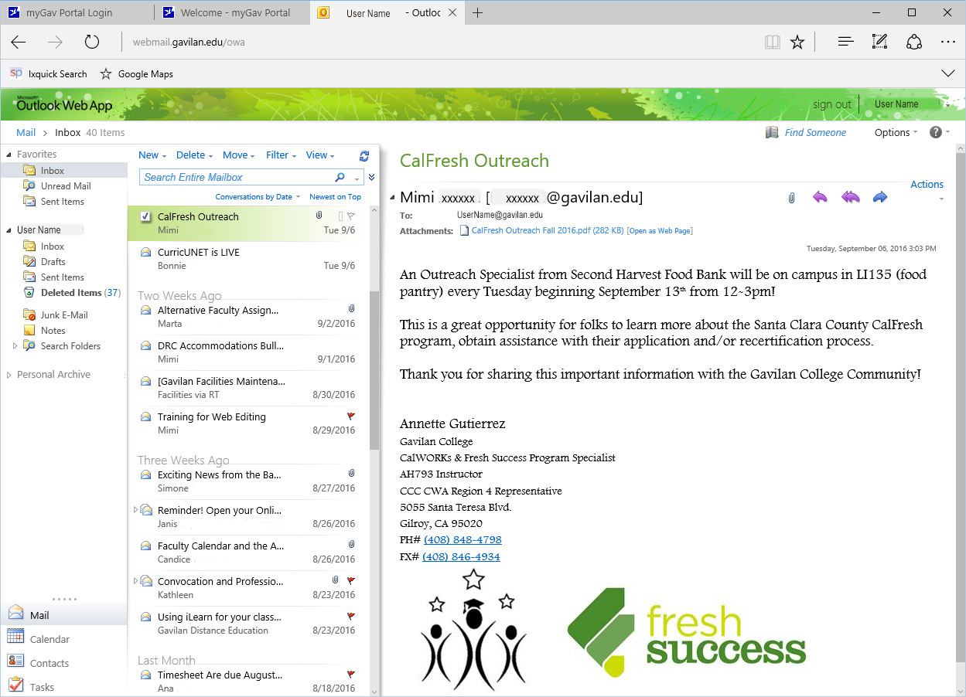
Computer and Internet Basics for ESL – Email
New – Write a new email. Some programs use Compose.
Delete – Remove the highlighted email. It goes to the Deleted Items folder.
Reply – Send back an answer to the person who sent you the email.
Reply All – Send back an answer to the email and to all the people it was sent to.
Inbox – This is main area where the mail comes to you.
Forward – Send this email to someone else.
Attachment – A paperclip shows that extra pages are attached to the email.
Sent – This is email you sent to other people.
email – This area shows the email that is highlighted so that you can read it.
Contacts – This is the list of people you know that you can write to. Some programs use Addresses.
Notes:
Email Netiquette (the correct or nice way of communicating on the Internet.)
When writing an email message, it is important to use good netiquette. For example, you should always include a subject that summarizes the topic of the email. It is also helpful to begin each message with the recipient's name and end the message with your name or "signature."
A signature may just be your name, but a formal signature will add your email address and your phone number. A professional signature will also include your company name and title. If you are writing many formal emails, most email programs allow you to save a signature which you can insert at the bottom of emails.
If you want to send an email to many people, add each email address to the "To" field. However, if the email is really for one person, and you just want the other people to know about it, you should place the additional addresses in the "CC" (carbon copy) field. If you are sending an email to multiple people that don't know each other, it is best to use the "Bcc" (blind carbon copy) field. This hides the email addresses of each recipient, which helps prevent spam (junk email and advertisements.)

Slide 13
PowerPoint Slide

Slide 14
Can I Use this Image?
You cannot use it!
No
You can use it as long as you follow the licensing directions: Creative Commons license, or the license you paid for.
Did you make it yourself?
Did you buy it, or get permission from the copyright holder?
No
Yes
Yes
Did you use any parts from someone else, or copy their work?
No
Is it only for personal use?
Is it Public Domain or Fair Use?
Yes
No
Yes
Yes
No
You can use it!
Notes:
Public Domain – Images without copyright; copyright released images, old images with expired copyrights, federal government images.
Fair Use – Where you change the meaning so that it becomes a different thing, or you use a very very small amount so that the copyright owner doesn’t suffer a loss, or you are working as a reporter telling the public factual information.
Creative Commons (http://creativecommons.org/) – Free images with a license that says how they are to be used.
Attribution: Do what you want, but give credit
Attribution-ShareAlike: Do what you want, but give credit and you must license the new creation with identical terms
Attribution-ShareAlike No Derivatives: No changes, and give credit
Creative Commons Zero (CC0) license: Completely free for any legal purpose
License – Official permission. A Model Release is required for any people in the image.
Some places to look for images:
https://www.google.com/advanced_image_search Toggle usage rights: free to use…
Free Images (http://www.sxc.hu/)
Morgue File (http://morguefile.com/)
Pexels (https://www.pexels.com/)
Pixabay (https://pixabay.com/)
Photo8 (http://www.photos8.com/)
Flickr Creative Commons (https://www.flickr.com/creativecommons/)
Wikimedia Commons (https://commons.wikimedia.org/wiki/Commons:Free_media_resources)

